Slide 1
INTRO Recap – SW04
Thomas Kempf
Urs Stöckli

Slide 2
State Machines
Function State Machine
If-elseif-else State Machine
Switch State Machine
Mealy State Machine

Slide 3
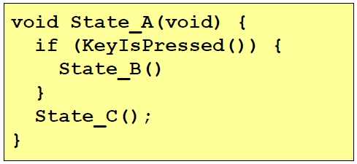
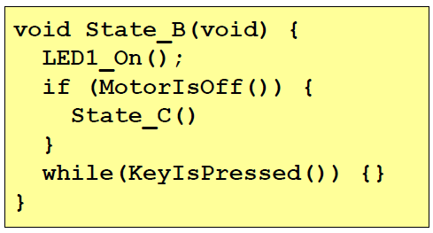
Function State Machine
Advantage
No global state variable needed
Disadvantage
Stack overflow possible
Recursion

Slide 4
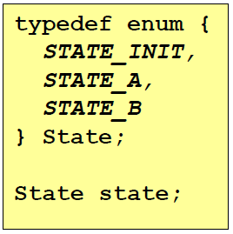
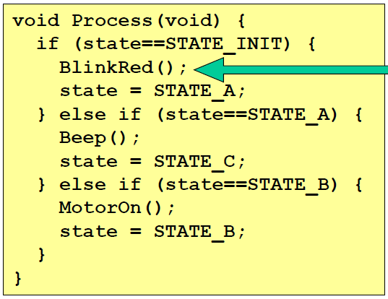

If-elseif-else State Machine
Disadvantage
Global state variable
Changing state outside processing
Volatile / reentancy!

Slide 5
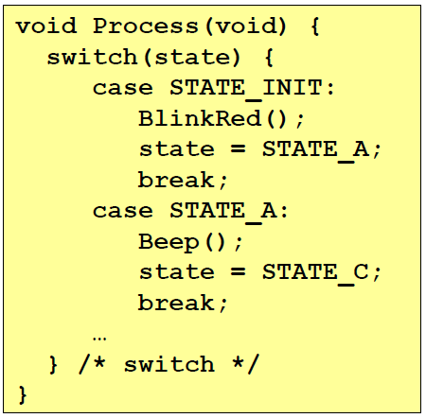
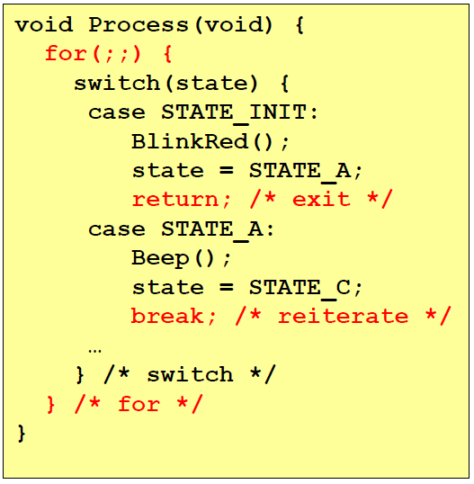
Switch State Machine
Advantage
Better structure
Disadvantage
Global state variable
Changing state outside processing
Volatile / reentrancy!
State change delayed with Processinterval
State change without Delay possible (break)

Slide 6
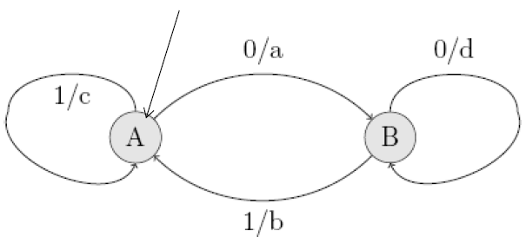
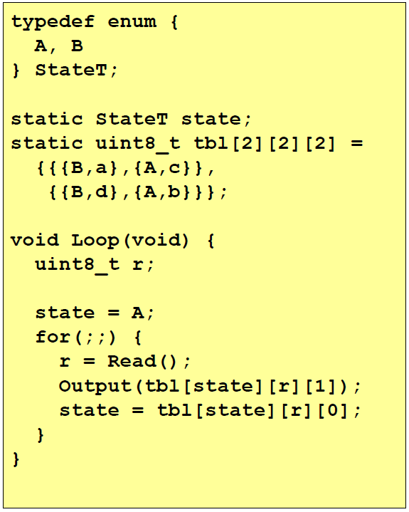
Mealy State Machine
State | 0 | 1
A | B/a | A/c
B | B/d | A/b

Slide 7
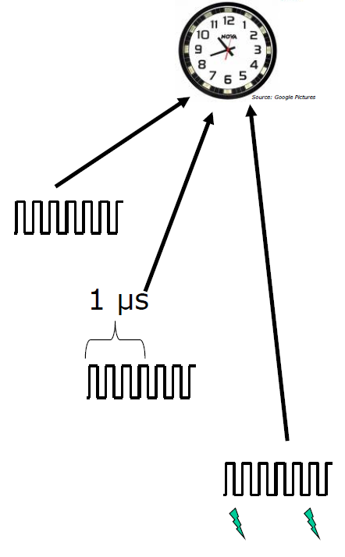
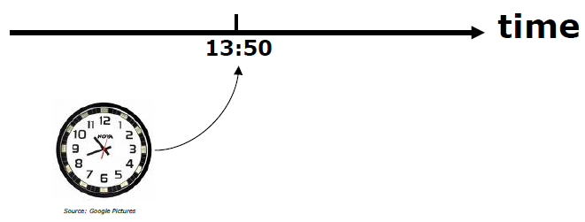
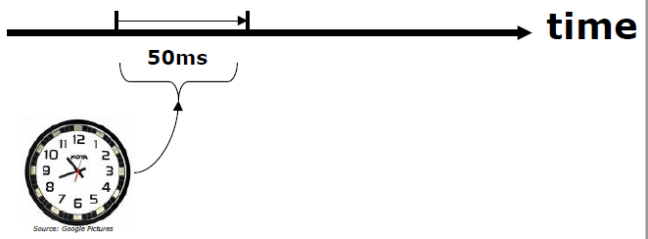
Clock & Timer
Clock
Absolute Time
Ticks per 1us
Relative Time
Set Event

Slide 8
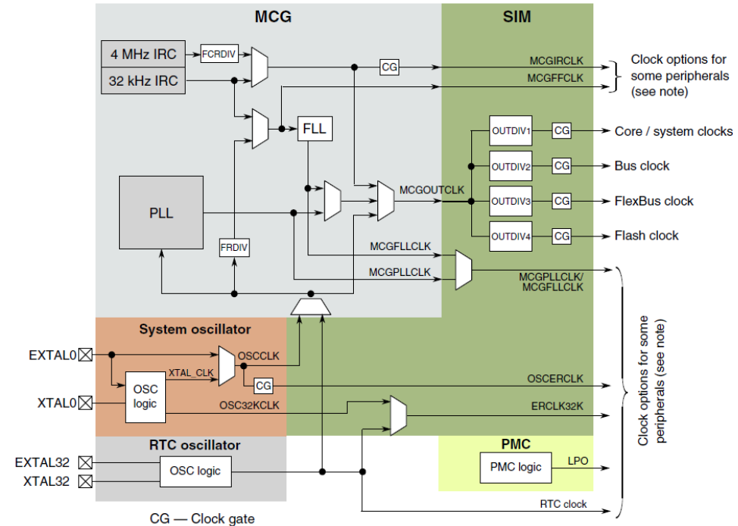
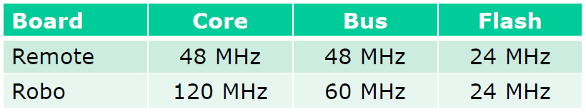
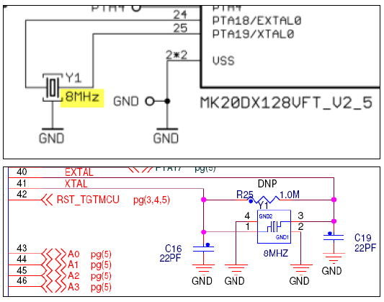
Clock

Slide 9
Questions
What is the job of the PLL in a microcontroller?
Frequency multiplication
What two different types of clock sources are available for the system clock?
Internal Clock
External Crystal/Oscillator
What is the advantage of the function state Machine?
No global variable needed

Slide 10
Questions
What is the job of the PLL in a microcontroller?
Frequency multiplication
What two different types of clock sources are available for the system clock?
Internal Clock
External Crystal/Oscillator
What is the advantage of the function state Machine?
No global variable needed

Slide 11
Questions
What is the job of the PLL in a microcontroller?
Frequency multiplication
What two different types of clock sources are available for the system clock?
Internal Clock
External Crystal/Oscillator
What is the advantage of the function state Machine?
No global variable needed

Slide 12
Questions
What is the job of the PLL in a microcontroller?
Frequency multiplication
What two different types of clock sources are available for the system clock?
Internal Clock
External Crystal/Oscillator
What is the advantage of the function state Machine?
No global variable needed

